Slide 1


Compositional Dynamic Test Generation
Mohammad Daghash

Slide 2

Content table
Problem: Testing complex software is hard, static methods often miss bugs.
Dynamic Testing: DART explores all paths, but gets overwhelmed by complexity.
Introducing SMART: A smarter way to explore, finding bugs efficiently.
How it Works: Summaries guide the search, focusing on relevant paths.
Benefits: Faster testing, better coverage, no false alarms.
Real-World Impact: See how SMART tackles a complex program.
Beyond SMART: Future directions for even smarter testing.

Slide 3


The Problem - Introducing the Challenge
Testing the maze-like complexity of large software programs has been a major hurdle. Techniques like DART(Directed Automated Random Testing) aim to explore all possible execution paths, but for intricate programs, this becomes a slow and inefficient maze run.
Notes:
DART is a dynamic test generation technique that strives to explore all feasible paths but struggles to scale for large programs.
SMART is a new algorithm that addresses DART's scalability limitations by performing dynamic test generation compositionally, breaking down the testing process into smaller, more manageable units.

Slide 4

SMART: A Smarter Way to Test
SMART(Systematic Modular Automated Random Testing) takes a different approach. Instead of tackling the whole maze at once, it breaks it down into smaller, manageable sections like rooms (functions).
SMART tests each function individually, capturing its behavior like a "functional blueprint" – a summary of required inputs and guaranteed outputs. These blueprints are then cleverly reused during the exploration of broader program sections, saving time and effort.
Notes:
SMART is like a clever builder that examines each part of a building separately, creating a simple plan for how each part should work. It then smartly uses these plans when looking at the whole building, saving a lot of time and effort.
When SMART tests a function (a smaller part of the program), it pays close attention to how that function behaves.
SMART doesn't forget about these blueprints after testing individual functions. Instead, it smartly reuses them when it looks at the entire program.

Slide 5

Key Results & Scalability Boost: Here's where SMART shines:
Sound and Complete: SMART ensures no path gets missed, maintaining full coverage like DART without compromising accuracy.
Linear Exploration: Unlike DART's exponential path explosion, SMART's exploration scales linearly with the complexity of individual functions, making it incredibly efficient for large programs.
Empirical Validation: Initial tests showcase SMART's effectiveness in navigating complex programs, proving its practical scalability advantage.
Notes:
SMART makes sure it doesn't miss any part of the program. It covers everything just like another testing method called DART but without losing accuracy.
Empirical validation: It provides evidence from actual experiments and tests to demonstrate whether SMART performs as well in practice as it does in theory.

Slide 6


Understanding Test Generation: From Million Lines to 50% Coverage
Imagine this: You have a massive book (a million lines of code!) and want to read at least half of it, but reading everything is overwhelming. Wouldn't it be great if you had a tool that could tell you which pages (inputs) would let you experience different parts of the book (code execution)?
That's the essence of the test generation problem: automatically finding inputs that "read" different parts of a program to ensure it works correctly. It's been around since the 70s, but creating practical tools has been tricky.
Notes:
This is the core of the test generation problem in software development. Programs, just like intricate books, are composed of lines of code representing its functionality. Testing involves "reading" the program by providing inputs and observing its behavior. But testing every possible input for a complex program is akin to reading every single page – laborious and impractical.
That's where test generation comes in. It's like having a smart assistant who analyzes the program's "structure" (think chapter summaries and indexes) and suggests specific inputs that trigger the execution of different program sections. The goal is to efficiently cover at least a significant portion of the program (like reading 50% of the book) to ensure its functionalities work correctly.

Slide 7

Why the difficulty? Two main reasons:
Complex analysis: Understanding intricate programs requires powerful tools like symbolic execution and constraint solvers, which were computationally expensive until recently. Think of them like sophisticated "book scanners" that analyze the text and connections within the book.
Limited tools: Advancements in computer power led to better software analysis tools like model checkers, theorem provers, and static analysis engines. These are like advanced "reading guides" that help navigate the book efficiently and find key points.
Notes:
In the analogy of reading a book (understanding a program), these tools are like a smart team. Symbolic execution and constraint solvers work like careful scanners, figuring things out without specific details. Model checkers and theorem provers act as clever guides, checking if the program follows certain rules. Static analysis engines are advanced guides, looking at the code's structure without running it. Altogether, these tools help understand complex programs, making the tough job easier.

Slide 8

Static vs. Dynamic Test Generation: Two Paths to Code Coverage
Imagine you're testing a vending machine:
Static Test Generation: This is like studying the machine's manual (the program code). You analyze the different buttons, coin slots, and product options to predict which combinations will activate different parts of the machine (code execution). You might create test cases like pressing specific buttons, inserting various coins, and expecting certain products to dispense.
Pros: Efficient, doesn't need to run the program, can catch potential errors early.
Cons: May miss hidden bugs, can be complex to analyze intricate programs.
Dynamic Test Generation: This is like actually using the vending machine. You try different buttons and coin combinations, observing what happens with each input. You might press random buttons, insert strange coins, and see how the machine reacts (program behavior).
Pros: Can find unexpected errors, good for exploring complex interactions.
Cons: Can be slow and inefficient, might miss certain paths if relying on random inputs.
Notes:
Static: It's like studying the manual to predict what might go wrong.
Dynamic: It's like playing with the vending machine to see what surprises might pop up.
Summary:
Static is quick and predictions, but might miss hidden stuff.
Dynamic is hands-on, finds surprises, but can take more time.

Slide 9
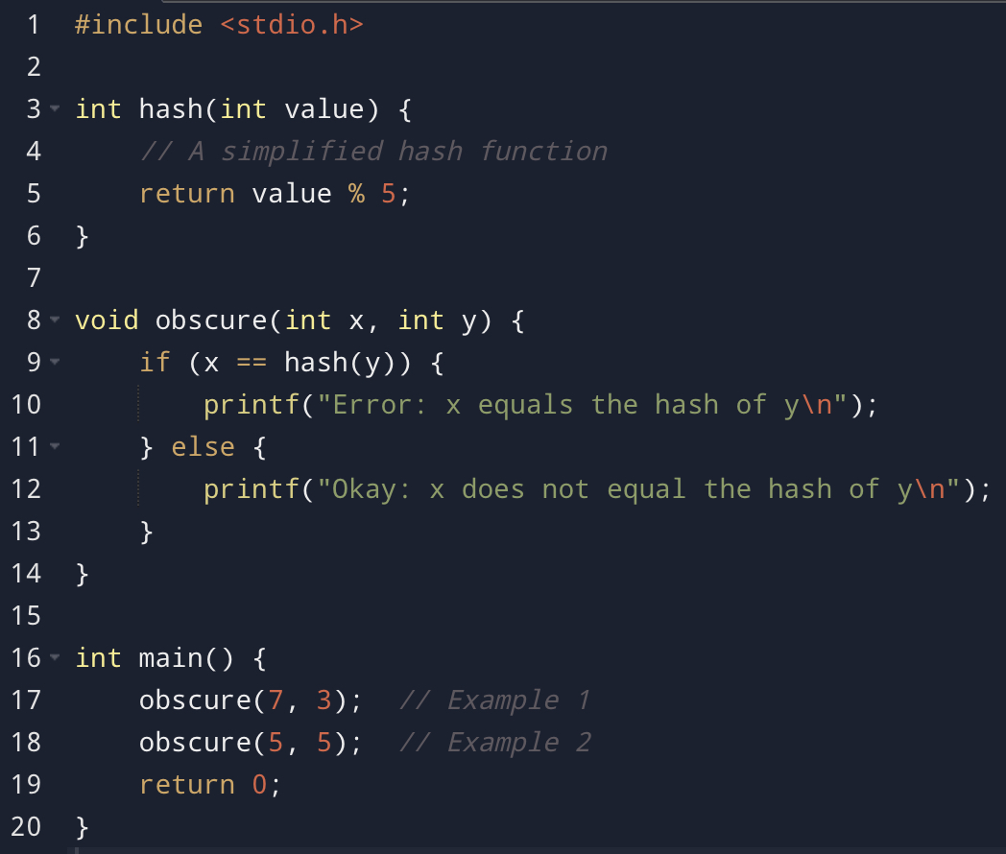
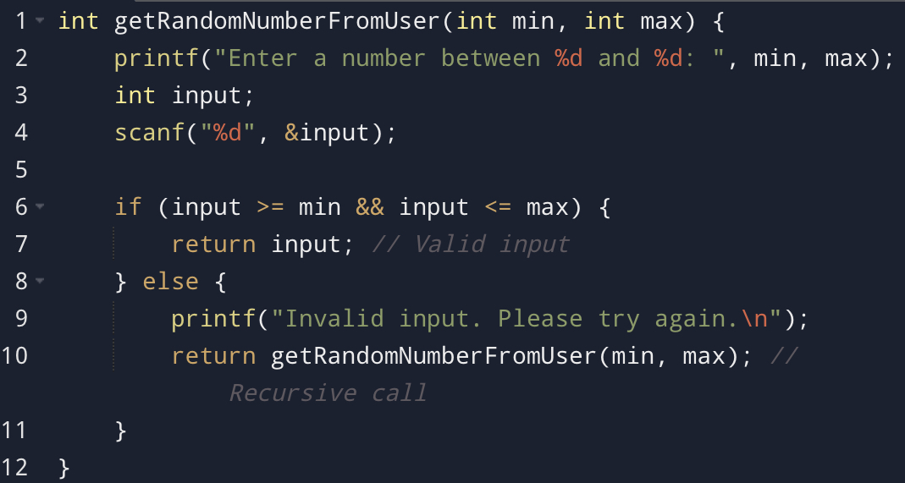
Why Static Test Generation Can Sometimes Stumble
External input: The function's behavior depends on user input, which is unpredictable and cannot be analyzed symbolically. Static analysis cannot determine what values the user might enter.
Recursive calls: The recursive nature of the function can lead to deeply nested paths and complex execution patterns, making it difficult for static analysis to track all possible execution paths accurately.
Notes:
Imagine a locked door in the maze labeled "Magic Portal" – you can't predict where it leads just by looking at the map.
Example: Consider a program with a function called obscure that checks if a number (x) equals the result of another function (hash(y)) – like comparing a key to a magic portal's code. If we can't understand how hash works (it's like the secret door mechanism), we can't predict which path the program will take (x == hash(y)) – even with the best map analysis.
The consequence: Static test generation becomes blind for parts of the program it can't analyze symbolically. In our maze analogy, it's like ignoring entire sections because the map doesn't show their secrets.

Slide 10

Unlocking Hidden Paths: How Dynamic Testing Goes Beyond Static Analysis
Imagine a multi-level maze filled with hidden doors and secret passages. Static test generation is like studying the blueprint of this maze (analyzing the program code) to predict which paths different inputs might unlock. But what if the blueprint is incomplete or there are hidden surprises?
That's where dynamic test generation comes in. Instead of just studying the blueprint, it's like actually exploring the maze by taking random turns and observing where you end up. With each step, you gather clues about the layout (program behavior) and use them to plan your next move (generate new inputs) to reach unexplored areas (different execution paths).
Here's the key difference:
Static test generation: Stuck at the blueprint stage, limited by what it can predict from the code alone.
Dynamic test generation: Adapts as you explore, using runtime information (clues gathered while running the program) to overcome limitations and reach hidden areas.
Notes:
Think of it like this:
Static test generation: Trying to find all the keys from the blueprint to unlock every door.
Dynamic test generation: Discovering hidden levers and secret passages as you explore, even if they weren't on the original blueprint.
Remember:
Dynamic testing isn't perfect, but it's a powerful tool that complements static analysis by exploring the program dynamically and adapting to the unknown.
SMART = Scalable DART
Example:
Remember the obscure function with the "magic portal" (hash(y))? Static analysis couldn't predict its behavior. But dynamic testing can simply run the program with a random y value, see what hash(y) is, and then use that information to choose an x value that triggers either the “if" or "else" branch, effectively exploring both paths.

Slide 11

DART Algorithm - A Treasure Hunt Approach
Imagine: You're on a forest treasure hunt, searching for hidden gems. Now, think of the forest as a program, the gems as bugs.
Traditional Search: Following marked paths (concrete execution) reveals bugs like finding clues.
Symbolic Exploration: Imagining alternative paths (symbolic execution) helps anticipate issues using symbolic clues.
Your Guide:
DART Algorithm: Your map, exploring both real and imagined paths systematically.
Instrumented Program: Your tool, tracking progress and revealing unexplored areas.
The Goal: Discover all bugs!
Notes:
The instrumented program performs concrete and symbolic execution, while the theorem prover focuses on logical reasoning about constraints.
Systematically- planned.

Slide 12

The DART Search Algorithm
DART is a powerful technique for automatically testing programs and uncovering hidden bugs. It works by:
Running the program twice:
Concretely: Executing the program with actual input values, like testing different paths through a maze.
Symbolically: Tracking potential future values of program variables, considering all possible paths.
Building an execution tree: Mapping out all possible program paths based on decisions (conditional statements).
Exploring the tree systematically:
Randomly: Trying different input values to discover new paths.
Directedly: Using symbolic constraints to force the program down unexplored branches.
Repeating until complete: Exploring all feasible paths in the execution tree to ensure thorough coverage.
Notes:
Random Exploration: Catches unexpected bugs that might be missed by targeted approaches.
Directed Exploration: It analyzes the information gathered during symbolic execution to create a "map" of potential paths.
It then uses this map to identify unexplored branches and cleverly calculates input values that will force the program to take those specific routes.
Random exploration discovers new paths and surprises, while directed exploration ensures targeted coverage.
This combined approach leads to a more comprehensive and efficient exploration of the program's execution tree, significantly increasing the chances of uncovering hidden bugs.
This cycle continues until DART achieves one of two outcomes: Completeness, or Exhaustion.

Slide 13
Choice Matters: Exploring Every Avenue with an Execution Tree
Consider a program that calculates a discount based on age and membership status:
Start
If age >= 18
Then
Else
If member
Print "No discount available"
Then
Else
End
Apply 20% discount
Apply 10% discount
Print“ Discount applied"
Print“ Discount applied"
End
End
Notes:
Each path represents a possible scenario based on the condition's outcome.

Slide 14

Benefits of DART:
Finds hidden bugs: Can uncover issues missed by traditional testing methods.
Efficient exploration: Combines random and directed search for effective path coverage.
Guaranteed results: Can report when all paths have been explored (completeness).
Limitations of DART:
May not explore all paths: Complex programs can have an immense number of paths, making complete exploration computationally challenging.
Relies on symbolic solvers: Effectiveness depends on the capabilities of the used solver.
Notes:
Some solvers might not be able to handle all types of constraints, potentially leaving certain program paths unexplored and bugs undetected.

Slide 15

Understanding Function Summaries in SMART
Think of them as concise blueprints that describe how a function operates under different input conditions.
They are expressed as logical formulas composed of constraints, which are rules that limit the acceptable values for inputs and outputs.
Structure of a Summary:
A summary is a disjunction (combination using "or") of smaller formulas called φw.
Each φw represents a possible execution path within the function.
φw is itself a conjunction (combination using "and") of two parts:
prew: Constraints on the function's inputs for that path.
postw: Constraints on the function's outputs for that path.

Slide 16
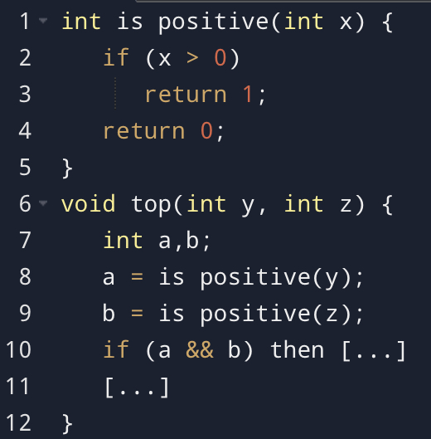
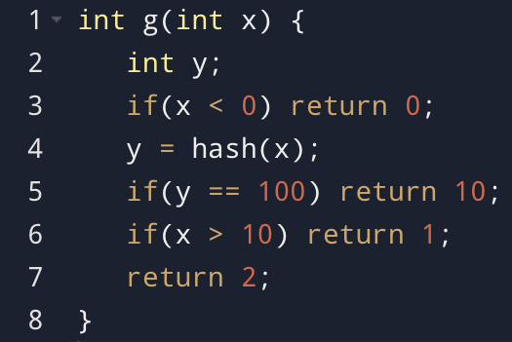
Code Example 1: is_positive function:
This simple function checks if a number is positive.
Its summary captures two possible behaviors:
(x > 0 ∧ ret = 1): If the input x is positive, the function returns 1.
(x ≤ 0 ∧ ret = 0): If the input x is non-positive, the function returns 0.
This summary is independent of how is_positive is called within the larger programs, making it reusable.
Code Example 2: g function:
This function demonstrates limitations in constraint representation.
The constraint (hash(x) == 100) might not be expressible in the theory T used for summaries.
This leads to an incomplete summary for the path taking all "else" branches, as it cannot guarantee unique behavior under different inputs.
This highlights the importance of the constraint theory's expressiveness for completeness guarantees.
Notes:
SMART can create summaries for larger programs by combining smaller ones, avoiding redundant exploration.

Slide 17

Computing summaries
Iterative Process:
Summaries are constructed by analyzing function paths one at a time.
For each path:
Precondition (prew): Created from branch conditions on inputs, ensuring the path is taken.
Postcondition (postw): Captures effects on outputs and memory for paths ending in a return statement. For paths ending in halt or abort, it's set to "false."
A summary for a path (φw) is the conjunction of prew and postw.
The overall function summary (φf) is a disjunction of summaries for all explored paths.
Notes:
For each path:
Precondition (prew): Think of it like a "key" to unlock the path. It's built by looking at the conditions along the way, like "x must be positive" for an "if x > 0" branch. This ensures only valid entries can take that path.
Postcondition (postw): This is like a "snapshot" of what happens at the end of the path. It captures what the function "returns" (output) and how it affects memory (changes made). If the path ends abruptly (halt or abort), it's like hitting a dead end, so "postw" is simply "false" (nothing happens).
Path summary (φw): Combining the "key" and "snapshot," we get a complete description of the path. It's like saying, "if this condition is met (prew), then the function will do this (postw)."
Overall function summary (φf): Now, imagine exploring all the paths in the function. The overall summary is like a big map, combining all the individual path descriptions (φw) with "or" (because different paths can lead to the same end). This map tells you all the possible ways the function can behave based on different inputs.

Slide 18

Top-Down vs. Bottom-Up Strategies:
Bottom-up: Starts with lower-level functions and moves up, reusing summaries.
Limitations:
May explore unrealistic behaviors that don't occur in actual usage.
Might miss paths due to symbolic execution constraints.
Top-down: Starts with higher-level functions and analyzes lower-level functions as needed.
Advantages:
Focuses on relevant behaviors within actual calling contexts.
Addresses incompleteness issues by exploring paths based on actual usage.
SMART adopts a top-down approach for efficiency and completeness.

Slide 19
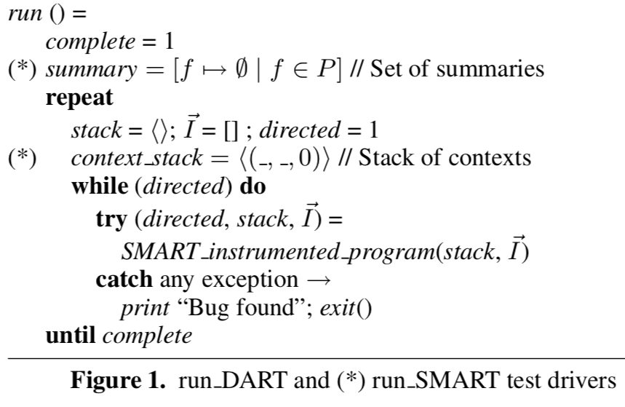
Shared Structure between DART and SMART test drivers:
Both drivers use a repeat loop to explore program paths until completion or bug discovery.
They employ try-catch blocks for exception handling (bug detection).
They terminate when complete is True.
run SMART advantages:
Function Summaries: Leverages function summaries (φf) to guide path exploration, improving efficiency and completeness.
Top-Down Approach: Starts with the top-level function and analyzes lower-level functions on demand, ensuring contextual relevance.
Context Stack: Maintains a stack of contexts to track function calls and their associated summaries, enabling compositional analysis.
Key Code Elements:
summary=[f !→∅|f ∈P]: Initializes empty summaries for all functions.
context stack = ⟨( , , 0)⟩: Creates a context stack to track exploration state.

Slide 20
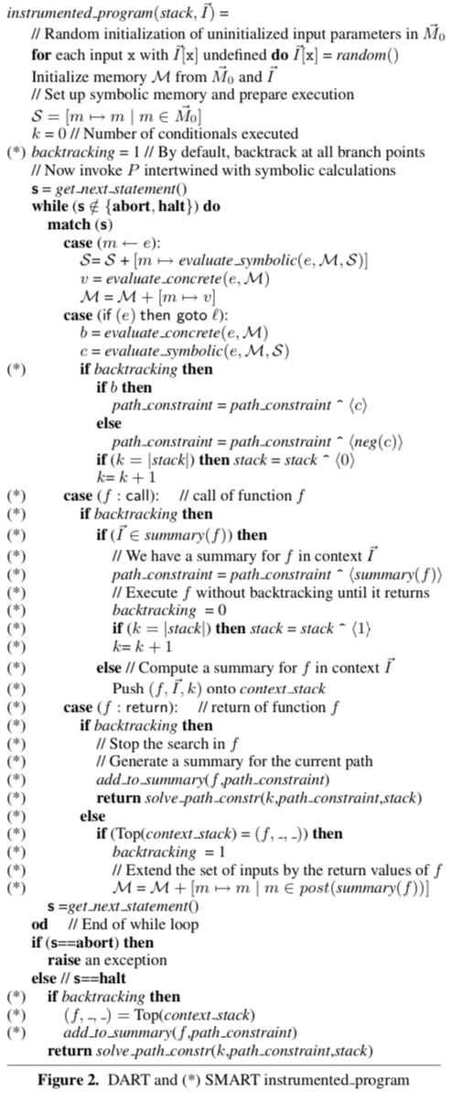
SMART's Engine: The Instrumented Program
What it does:
Executes the program with symbolic calculations, exploring hidden paths.
Manages backtracking to avoid exploring the same paths repeatedly.
Gathers information about functions (summaries) to guide exploration efficiently.
Tracks the program's execution path (path constraint) for analysis.
Handles different program elements like assignments, conditions, function calls, and returns.
Uses a stack to remember how it got to the current point in the program.
Enables SMART's top-down approach, exploring functions one by one.
Notes:
This program is the heart of SMART, dynamically exploring the program and finding potential bugs in a smart way!

Slide 21
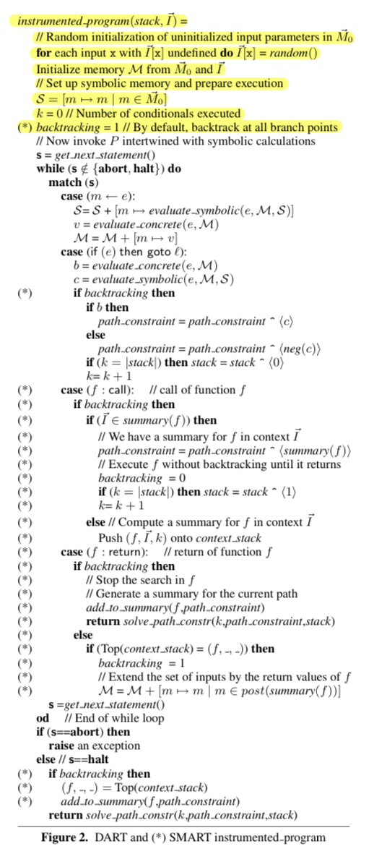
Initialization:
Uninitialized input parameters in I⃗ are randomly initialized.
Symbolic memory S is set up, mapping each memory address to itself.
k is initialized to 0, representing the number of conditionals executed.
backtracking is set to 1 by default, indicating that backtracking is allowed at all branch points.

Slide 22
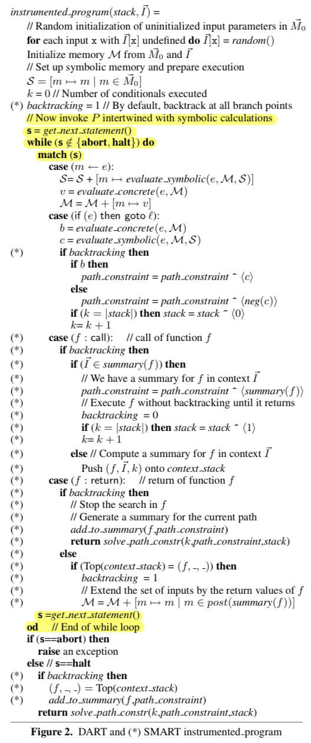
this part of the code establishes a loop that iterates through the statements of the program, executing each statement's logic and fetching the next statement until the program either completes its execution (halt) or encounters an error (abort). The match block is crucial for handling the different types of statements and directing the program flow accordingly.

Slide 23
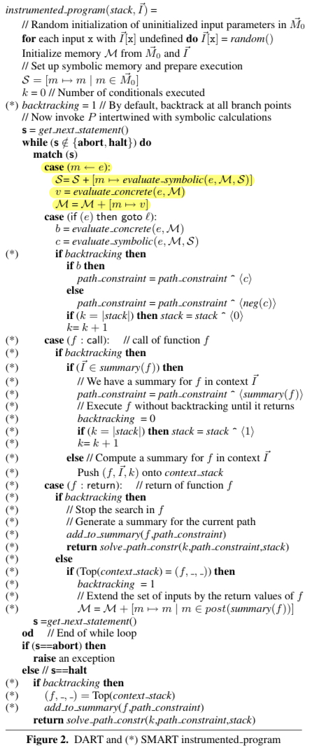
Case Declaration:
It is checking if the current statement s is an assignment statement of the form m ← e, where m is a memory address and e is an expression.
Update Symbolic Memory (S):
Evaluate_symbolic(e, M, S) calculates the symbolic value of the expression e in the context of the current memory (M) and symbolic memory (S).
Evaluate Concrete Value:
v = evaluate_concrete(e, M): This line evaluates the concrete (actual) value of the expression e in the context of the current memory M.
The result (v) is the actual value that will be assigned to the memory address m.
Update Memory (M): Updates the concrete memory (M) with the new assignment.
Notes:
Purpose: The whole process ensures that the computer correctly follows instructions to remember information in its memory. This is crucial for the algorithm, especially when dealing with different execution paths and ensuring that the computer accurately tracks and processes information as it goes through the program.

Slide 24
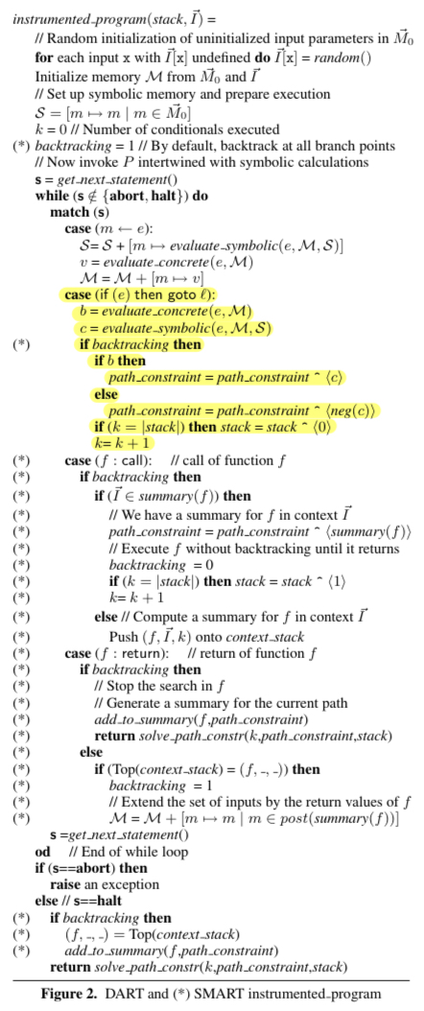
Backtracking Check:
if backtracking then: This block of code executes only if the algorithm is currently in a backtracking state.
Update Path Constraint:
if b then path_constraint = path_constraint ^ ⟨c⟩: If the condition is true (b is true), it appends the symbolic condition (c) to the path constraint (path_constraint).
else path_constraint = path_constraint ^ ⟨neg(c)⟩: If the condition is false, it appends the negation of the symbolic condition to the path constraint.
Update Stack:
If the stack is at its maximum length, it appends 0 to the stack.
Notes:
If we encounter an if statement where the condition e is True, jump to the code section labeled l.
This part of the code keeps track of conditions in the program, helping to remember what choices were made during its execution and building a record of how the program behaves in different situations.

Slide 25
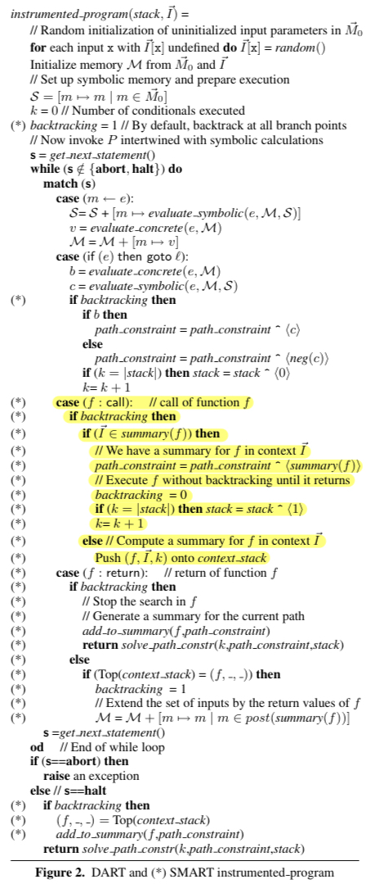
Handling Function Calls:
For function calls (f: call), it checks if there's a summary available for the current context.
If yes, it uses the summary, turns off backtracking, and continues execution.
If no summary is available, it pushes the current context onto the context stack for later processing.
Notes:
This part of the code is handling a function call statement. If the algorithm is currently backtracking (i.e., revisiting a previous execution path), it checks if there is already a summary available for the current function `f` in the given context `I⃗`. If such a summary exists, it means that the behavior of the function is already known for this context, and the algorithm proceeds to execute the function without backtracking until it returns. If there is no summary for `f` in the current context, it means the algorithm has not explored this scenario yet. In this case, it pushes the information about the function call (function `f`, context `I⃗`, and the current conditional count `k`) onto the context stack. The purpose is to continue the search in the called function, computing its summary and exploring its execution paths.
Adding 0 to the stack signifies encountering a previously explored function call with an existing summary, while adding 1 indicates encountering a new instance of the function call requiring summary computation.

Slide 26
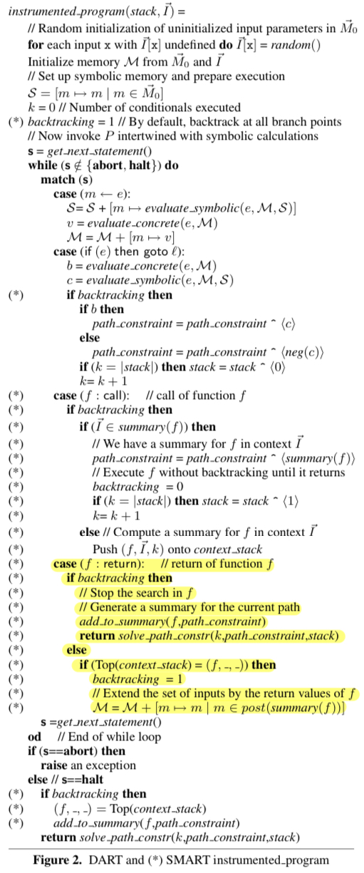
In this part of the code, when the program reaches a "return" statement in a function, it does two things:
Backtracking Enabled: If the program is backtracking (going back to explore different paths), it stops exploring within the current function and creates a summary of the path taken so far. Then, it goes back to where the function was originally called and continues the search.
Backtracking Not Enabled: If there's no backtracking (meaning it's part of the normal program flow), the algorithm checks if it's returning from the most recent function call. If it is, it allows backtracking and includes the return values of the function in the set of inputs.
In simpler terms, it's like deciding whether to explore different options or just continue with the regular flow of the program.
Notes:
In summary, this code block manages the handling of return statements in the algorithm. It decides whether to generate a summary for the current path, stop the search within the function, and potentially enable backtracking for future exploration. The return values of the function are used to enhance the available information.
Calling solve_path_constr to determine the next backtracking point.

Slide 27
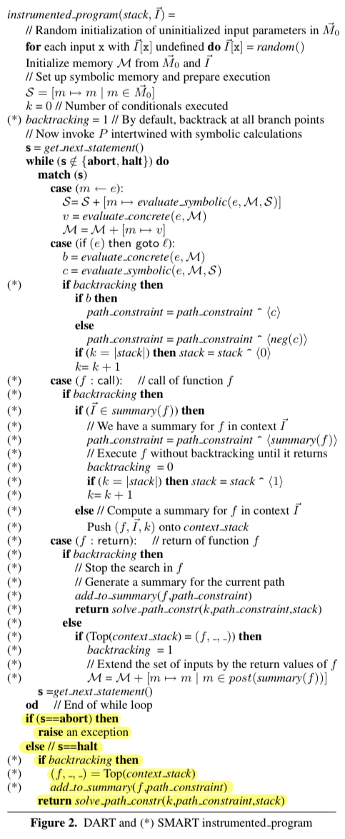
Checking if the Statement is "abort":
The algorithm raises an exception, signaling that something unexpected happened, and the normal program flow cannot continue.
If Statement is "halt" and Backtracking is Enabled:
If backtracking is enabled, meaning the algorithm is exploring different paths:
It retrieves the top context from the context stack (the most recent calling context) and assigns it to (f, , ).
It adds the summary of the function f with the accumulated path constraint to the overall summaries.
The algorithm then returns and continues with the process of solving path constraints.
Notes:
In simpler terms, this part ensures that the algorithm appropriately responds to the conclusion of the program's execution, handling both unexpected issues and the completion of the program, especially in the context of exploring different paths during dynamic test generation.

Slide 28
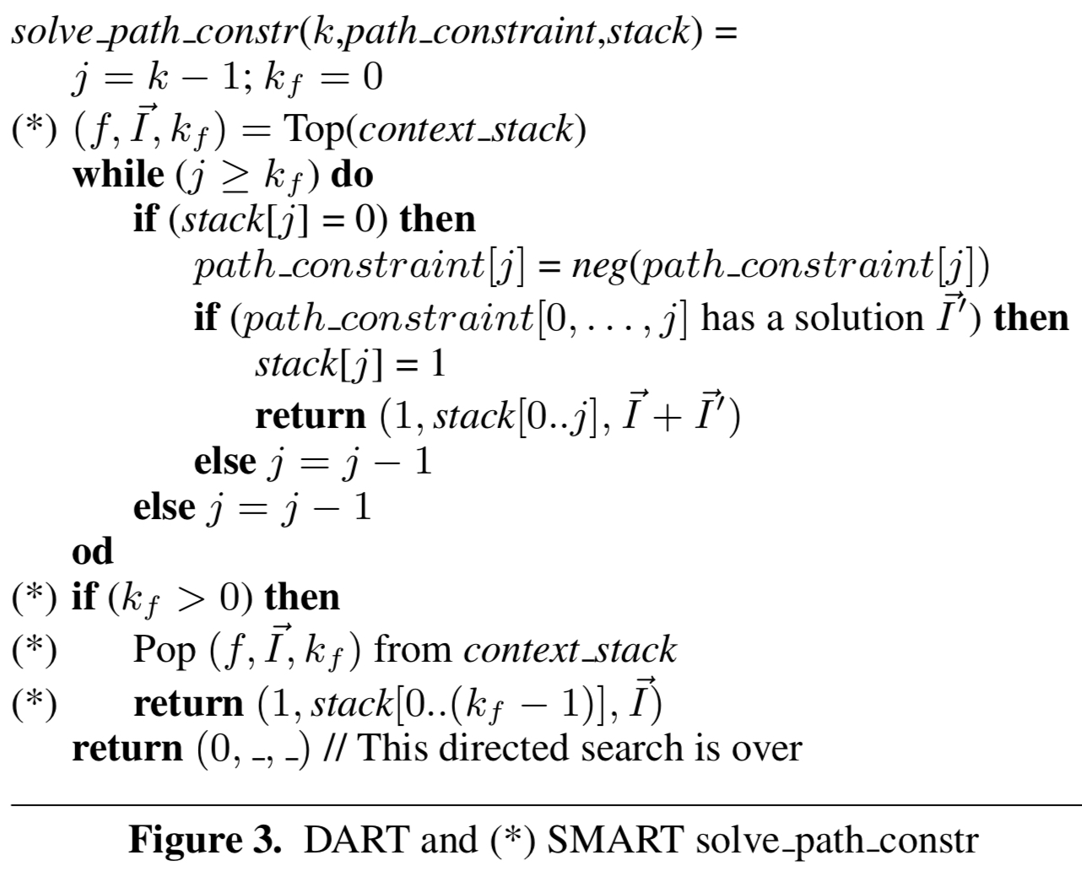
Navigating Program Paths: The Role of solve_path_constrn
Purpose: Guides backtracking to explore different program paths.
Inputs: Path constraint, stack, backtracking point.
Core Steps:
Initialization
Backtracking loop
Function context handling (SMART only)
Termination
Notes:
Purpose of solve_path_constrn:
To decide where to backtrack next for exploring alternative execution paths.
kf is not directly updated within solve_path_constrn, but it can be greater than 0 due to its connection to the context stack and function call history in the SMART algorithm.

Slide 29
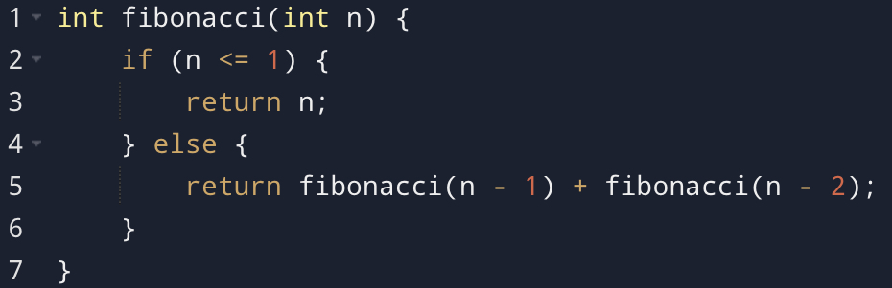
Efficiency Comparison: SMART vs. DART
The time complexity of the Fibonacci code using SMART is linear (O(n)), while the time complexity using DART would be exponential (O(2^n)). SMART efficiently handles the recursive nature of the Fibonacci code by leveraging function summaries and compositional reasoning, resulting in a linear exploration of feasible paths. In contrast, DART, without the benefits of compositional reasoning, tends to explore an exponential number of paths, making it less efficient for recursive programs.

Slide 30

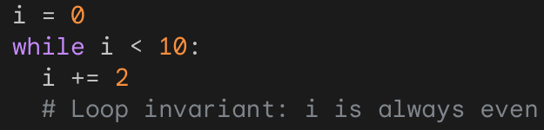
Beyond SMART: Exploring the Horizon of Testing Efficiency
Advanced Summarization
Machine Learning Integration:
While SMART represents a major leap forward, the quest for even more efficient and effective automated testing remains ongoing.
Imagine capturing program behavior even more concisely. Loop invariants could summarize repeated patterns, leading to fewer exploration steps and faster test generation.
Picture AI algorithms learning from execution traces and suggesting unexplored paths with high bug potential. This dynamic adaptation could identify subtle bugs missed by traditional approaches.
Notes:
i = 0while i < 10: i += 2 # Loop invariant: i is always even# After the loop, i will be 10, which is still even
When summarizing functions with loops, exploring every single iteration can be unnecessary and time-consuming.

Slide 31

Summary
DART:
Promising test generation tool, combining static and dynamic analysis.
Challenges:
Limited by symbolic reasoning capabilities.
Suffers from "path explosion" for complex programs.
SMART addresses the path explosion problem:
Analyzes paths compositionally, reducing overall exploration.
Maintains full path coverage without sacrificing soundness (no false alarms).
Leverages function summaries for efficiency.

Slide 32

Questions?

Slide 33


